Slide 1
Chapter 12
Lecture 14 & 15
CPU Structure and Function

Slide 2
CPU Structure and Function
Review
  Processor Organization
  Register Organization
  Instruction Cycle
Instruction Pipelining
The Pentium Processor
CH11

Slide 3
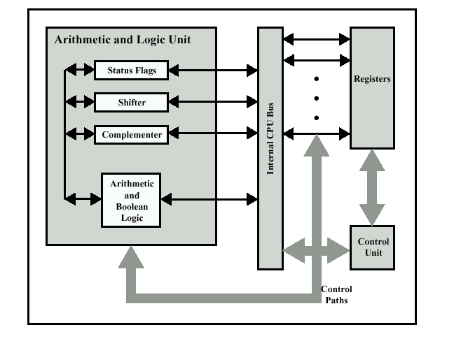
CPU Internal Structure

Slide 4
CPU Function
CPU must:
  Fetch instructions: The CPU reads an instruction from memory
  Interpret instructions: The instruction is decoded to determine the action
  Fetch data: The execution of instruction require reading data from memory or an I/O module
  Process data: Performing some arithmetic or logical operation on data
  Write data: Execution results may require writing data to memory or an I/O module
Notes:
22

Slide 5
Registers
CPU must have some working space (temporary storage)
  Called registers
Number and function vary between processor designs
One of the major design decisions
Top level of memory hierarchy
Notes:
23

Slide 6
User Visible Registers
General Purpose registers
Data registers
Address registers
Condition Codes or Flag register
Notes:
24

Slide 7
General Purpose Registers (1)
Can be assigned to variety of tasks by the programmer
May be restricted e.g. dedicated registers for floating point and stack operation
May be used for data or addressing
Data register is used to hold data
  Accumulator
Addressing register is devoted to particular addressing mode
  Segment register
Notes:
25

Slide 8
How Many GP Registers?
Between 8 - 32
Fewer = more memory references
More does not reduce memory references and takes up processor area
Register size
  Large enough to hold full address
  Large enough to hold full word
  Often possible to combine two data registers
    C programming
      double int a;
      long int a;
Notes:
27

Slide 9
Condition Code Registers
Also referred to as flags
Sets of individual bits
  e.g. result of last operation was zero
Can be read (implicitly) by programs
  e.g. Jump if zero
Can not (usually) be set by programs
Notes:
29

Slide 10
Program Status Word or Flag register
A set of bits
Includes Condition Codes
Sign of last result
Zero
Carry
Equal
Overflow
Interrupt enable/disable
Supervisor
Notes:
31

Slide 11
Control & Status Registers
Most of them are not visible to the user
  Program Counter: Contains address of the next instruction to be fetched
  Instruction Decoding Register: Contains the instruction most recently fetched
  Memory Address Register: Contains the address of a location in memory, connects directly to the address bus
  Memory Buffer Register: Contains a word of data to be written to memory or the word most recently used, connects directly to the data bus
Revision: what do these all do?
Notes:
30

Slide 12

Example Register Organizations

Slide 13

Instruction Cycle //
Two steps:
  Fetch: read the next instruction from memory into CPU
  Execute: Interpret the opcode and perform the indicated operation
  Interrupt: If interrupts are enabled and interrupt has occurred, save the current process state and service the interrupt

Slide 14

Instruction Cycle with Interrupts

Slide 15
Indirect Cycle (for indirect addressing)
The execution of an instruction may involve one or more operands in memory
Indirect addressing requires more memory accesses
Can be thought of as additional instruction subcycle

Slide 16
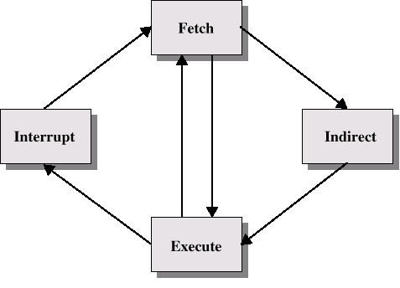
Instruction Cycle with Indirect

Slide 17

Instruction Cycle State Diagram

Slide 18
Data Flow (Instruction Fetch)
Depends on CPU design
In general:
  Fetch
    PC contains address of next instruction
    Address moved to MAR
    Address placed on address bus
    Control unit requests memory read
    Result placed on data bus, copied to MBR, then to IR
    Meanwhile PC incremented by 1

Slide 19
Data Flow (Data Fetch)
IR is examined
If indirect addressing, indirect cycle is performed
  Right most N bits of MBR transferred to MAR
  Control unit requests memory read
  Result (address of operand) moved to MBR

Slide 20

Data Flow (Fetch Diagram)

Slide 21

Data Flow (Indirect Diagram)

Slide 22
Data Flow (Execute)
Unpredictable data flow
May take many forms, depends on instruction being executed
May include
  Memory read/write
  Input/Output
  Register transfers
  ALU operations

Slide 23
Data Flow (Interrupt)
Simple
Predictable
Current PC saved to allow resumption after interrupt
Contents of PC copied to MBR
Special memory location (e.g. stack pointer) loaded to MAR
MBR written to memory
PC loaded with address of interrupt handling routine
Next instruction (first of interrupt handler) can be fetched

Slide 24

Data Flow (Interrupt Diagram)

Slide 25
Prefetch
Fetch accessing main memory
Execution usually does not access main memory
Can fetch next instruction during execution of current instruction
Called instruction prefetch
Notes:
36

Slide 26
Improved Performance
But not doubled:
  Fetch usually shorter than execution
    Prefetch more than one instruction?
  Any jump or branch means that prefetched instructions are not the required instructions
Add more stages to improve performance
Notes:
37

Slide 27
Pipelining
Fetch instruction
Decode instruction
Calculate operands (i.e. EAs)
Fetch operands
Execute instructions
Write result
Overlap these operations
Notes:
38

Slide 28
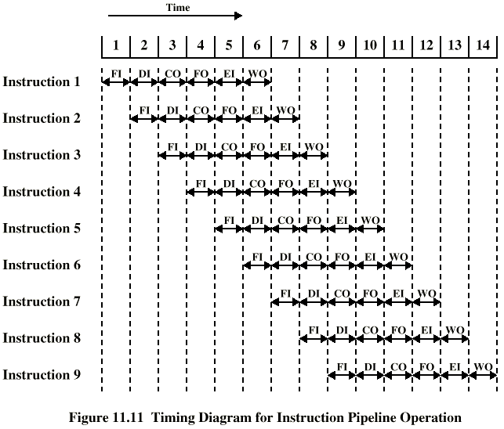
Timing of Pipeline
Notes:
39

Slide 29
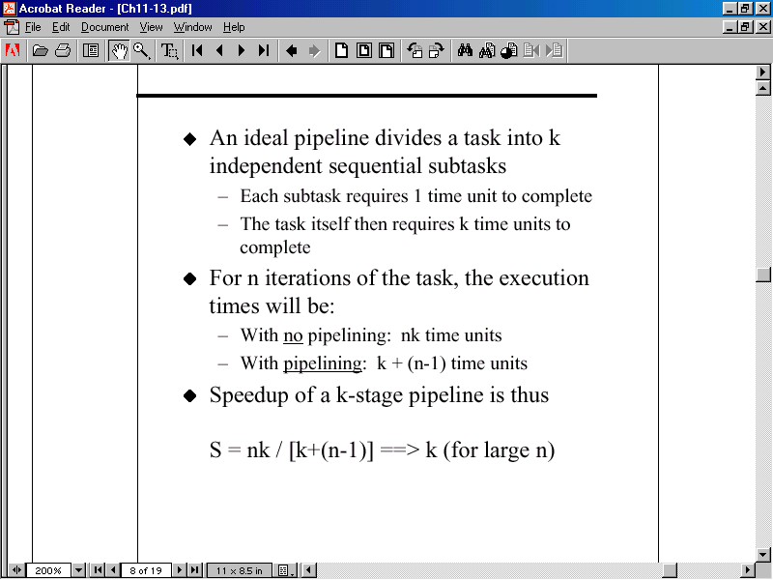
Speedup using Pipeline

Slide 30
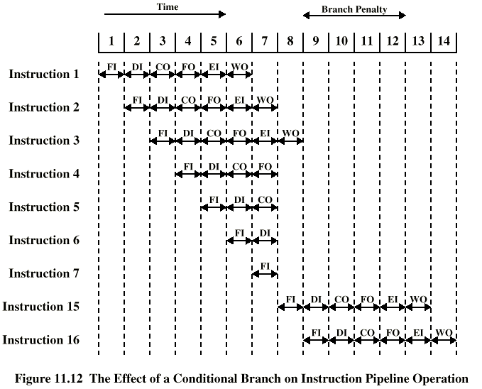
Branch in a Pipeline
Notes:
40

Slide 31
Dealing with Branches
Multiple Streams
Prefetch Branch Target
Loop buffer
Branch prediction
Delayed branching
Notes:
41

Slide 32
Multiple Streams
Have two pipelines
Prefetch each branch into a separate pipeline
Use appropriate pipeline
Leads to bus & register contention
Multiple branches lead to further pipelines being needed
Notes:
42

Slide 33
Prefetch Branch Target
Target of branch is prefetched in addition to instructions following branch
Keep target until branch is executed
Used by IBM 360/91
Notes:
43

Slide 34
Loop Buffer
Very fast memory
Maintained by fetch stage of pipeline
Check buffer before fetching from memory
Very good for small loops or jumps
c.f. cache
Used by CRAY-1
Notes:
44

Slide 35
Branch Prediction (1)
Predict never taken
  Assume that jump will not happen
  Always fetch next instruction
  68020 & VAX 11/780
  VAX will not prefetch after branch if a page fault would result (O/S v CPU design)
Predict always taken
  Assume that jump will happen
  Always fetch target instruction
Notes:
45

Slide 36
Branch Prediction (2) //
Predict by Opcode
  Some instructions are more likely to result in a jump than thers
  Can get up to 75% success
Taken/Not taken switch
  Based on previous history
  Good for loops
Notes:
46

Slide 37
Branch Prediction (3)
Delayed Branch
  Do not take jump until you have to
  Rearrange instructions
Notes:
47

Slide 38
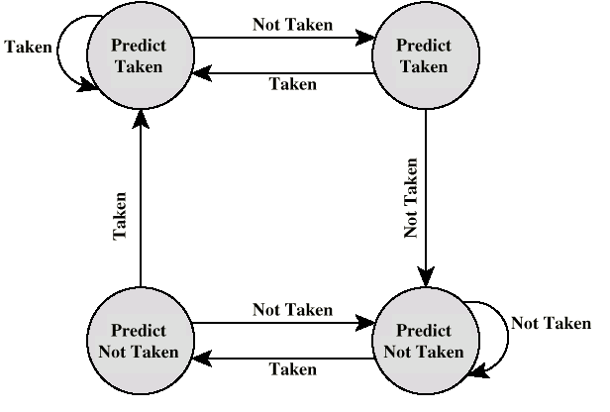
Branch Prediction State Diagram

Slide 39
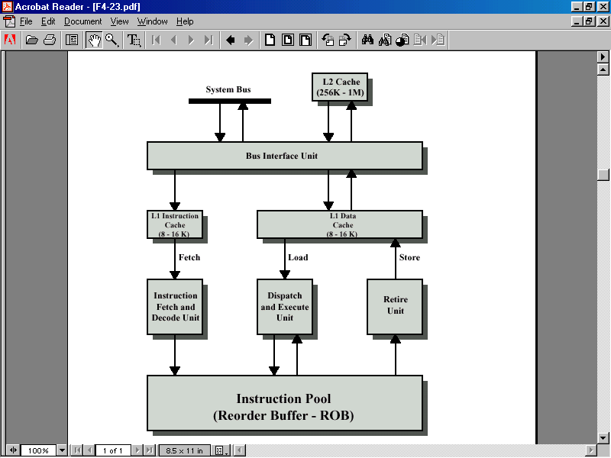
Pentium II Block Diagram

Slide 40
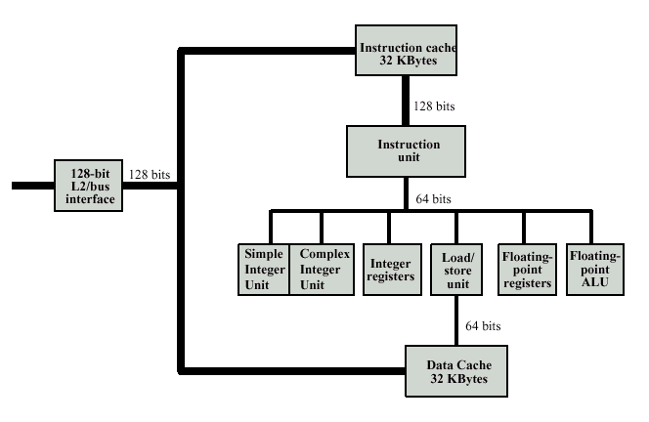
PowerPC G3 Block Diagram

Slide 41
Foreground Reading
Processor examples
Stallings Chapter 11
Web pages etc.
Notes:
48

